Slide 1
Maximum / Minimum / Points of Inflexion
Learning Objective:
By the end of this lesson I will be able to tell if a turning point on a graph is a maximum point, minimum point or a point of inflexion by considering the gradients of the curve either side of the stationary points.

Slide 2
Maximum / Minimum / Points of Inflexion
Turning points on graphs have a gradient of zero,
hence ^{dy}/_{dx} = 0.
Maximum points are where the gradient of the graphs changes from positive to negative.
Minimum points are where the gradient of the graphs changes from negative to positive.
Points of inflexion are where the gradient is positive then zero then positive or negative, then zero then negative again.

Slide 3
Maximum / Minimum / Points of Inflexion
Maximum
y = x³ + 3x² – 4x
Minimum

Slide 4
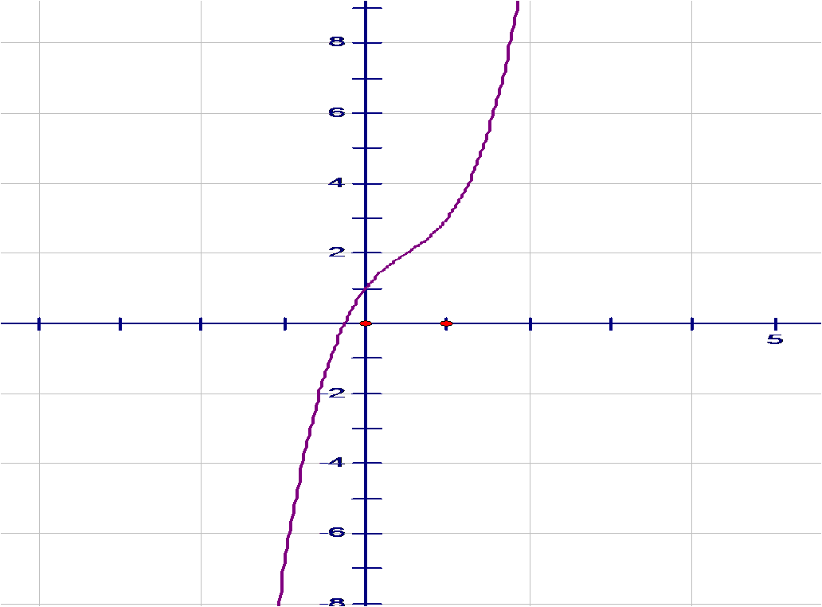
Maximum / Minimum / Points of Inflexion
y = x³ – 3x² + 3x + 1
Point of Inflexion

Slide 5
Maximum / Minimum / Points of Inflexion
By considering the gradients either side of the stationary points, determine whether the turning points of the graph y = x³ - 2x² – 5x + 3
3
are points of maximum, minimum or inflexion.
For turning points, ^{dy}/_{dx} = 0
^{dy}/_{dx} = 3x² - 4x - 5
3
^{dy}/_{dx} = x² - 4x - 5

Slide 6
Maximum / Minimum / Points of Inflexion
If ^{dy}/_{dx} = 0
x² - 4x - 5 = 0
(x - 5)(x + 1) = 0
either x - 5 = 0
∴x = 5
or x + 1 = 0
∴ x = -1
Factorise & solve quadratic

Slide 7
Maximum / Minimum / Points of Inflexion
^{dy}/_{dx} = x² - 4x - 5
Choose easy to use values for x either side of -1 and 5
x
-2
-1
0
5
6
^{dy}/_{dx}
7
0
- 5
0
7
Gradient
Maximum
Minimum

Slide 8
Maximum / Minimum / Points of Inflexion
We can find the y co-ordinates of the turning points by substituting the x values into the equation of the original line.
x co-ordinates of turning points are -1 and 5
Equation of line is y = x³ - 2x² – 5x + 3
3
If x = 5
y = 5³ – 2x5² - 5x5 + 3 =
3
- 30⅓

Slide 9
Maximum / Minimum / Points of Inflexion
If x = -1
y = (-1)³ – 2x(-1)² - 5x-1 + 3 =
3
Co-ordinates of turning points are
5⅔
(-1, 5⅔)
and
(5, -30⅓)

Slide 10
Maximum / Minimum / Points of Inflexion
y = x³ - 2x² – 5x + 3
3
(-1, 5⅔)
(5, -30⅓)

Slide 11
Maximum / Minimum / Points of Inflexion
Edexcel Core Mathematics 2
Exercise 9B questions 1, 2 5

